Slide 1
Module 1 : Lesson 4 Big Data Challenges

Slide 2
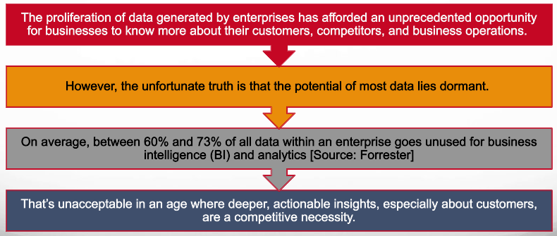
The Challenge Posed by Big Data

Slide 3
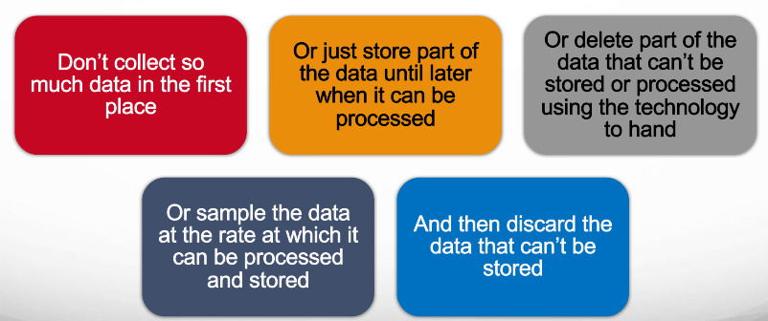
Why is Big Data a Challenge? Can We Just Avoid Using Big Data

Slide 4
Why is Big Data a Challenge? But Big Data is Inevitable
Sometimes collecting large volumes of data is the point
Large Hadron Collider experiments to discover new physics
Images and other data from missions to the moon or Mars
Twitter, Facebook, Snapchat, YouTube, Instagram and so on
Sometimes big data happens (unexpectedly)
An ecommerce site starts small and then usage grows
Data collected about each user starts small and then is augmented with more details
Sometimes big data is a competitive business choice
Understand your customer better than other similar businesses
Or to meet some governance, legal or regulatory requirements
Sometimes it makes no sense to only sample data
Can’t record or analyze every other order a customer places or every other fire alarm indication
Sometimes more data is required for data analytic reasons
More effective sentiment analysis or population health trending analysis
Good predictive algorithms applied to large data sets are often more accurate than great algorithms applied to smaller data sets

Slide 5
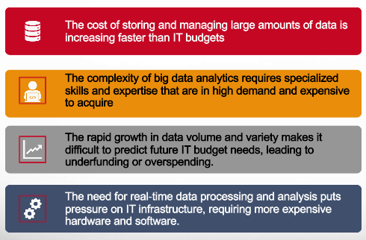
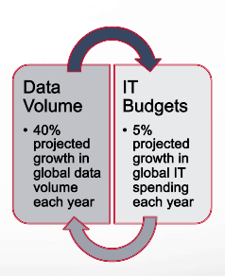
The Economic Challenges of Big Data

Slide 6
Other Big Data Challenges
Data privacy
Data security
Data discrimination
The Big Data we now generate contains a lot of information about our personal lives, much of which we have a right to keep private.
Increasingly, we are asked to strike a balance between the amount of personal data we divulge, and the convenience that Big Data-powered apps and services offer.
Even if we decide we are happy for someone to have our data for a particular purpose, can we trust them to keep it safe?
We already use credit scoring to decide who can borrow money, and insurance is heavily data-driven.
We can expect to be analyzed and assessed in greater detail, and care must be taken that this isn’t done in a way that contributes to making life more difficult for those who have fewer resources, and limited access to information.

Slide 7
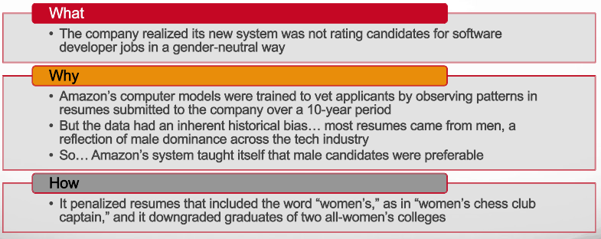
Amazon Scraps Secret AI Recruiting Tool (that showed bias against women)
https://www.reuters.com/article/us-amazon-com-jobs-automation-insight/amazon-scraps-secret-ai-recruiting-tool-that-showed-bias-against-women-idUSKCN1MK08G

